Slide 1
The battle of neighborhood (part 2)
This project is the final project for the course "Applied data science capstone"

Slide 2
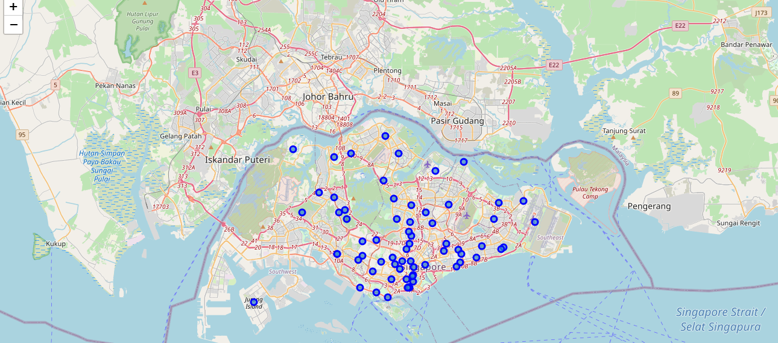
Plot neighborhood on Singapore map

Slide 3
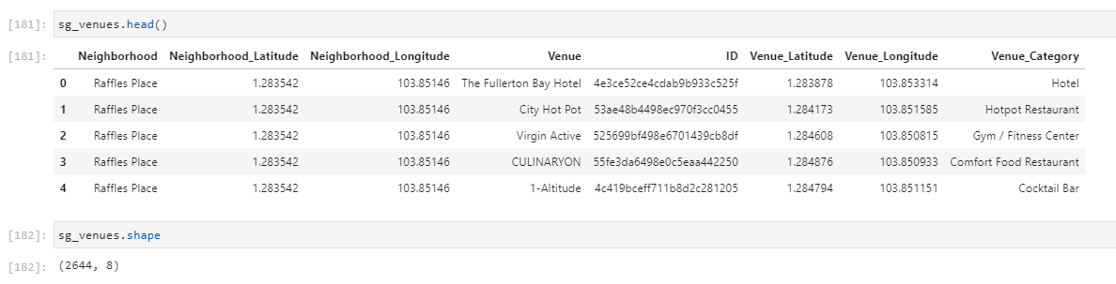
Retrieve all venues data, store in dataframe

Slide 4
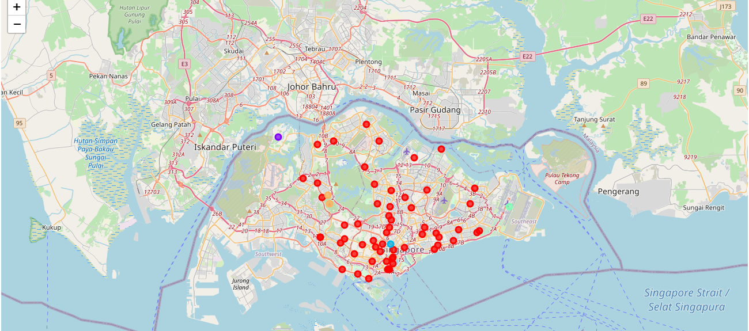
Group the neighborhood using K-mean algorithm

Slide 5
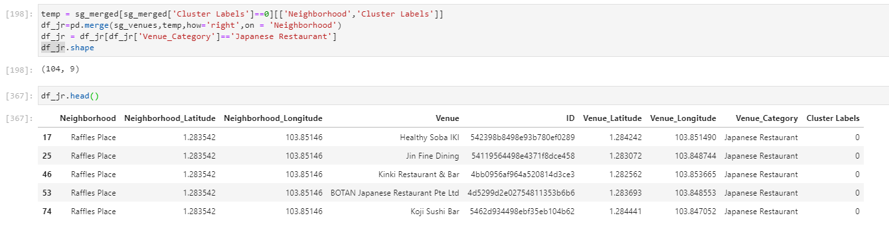
Focus on the Japanese restaurant belongs to cluster 0, where neighborhoods located in residential area

Slide 6
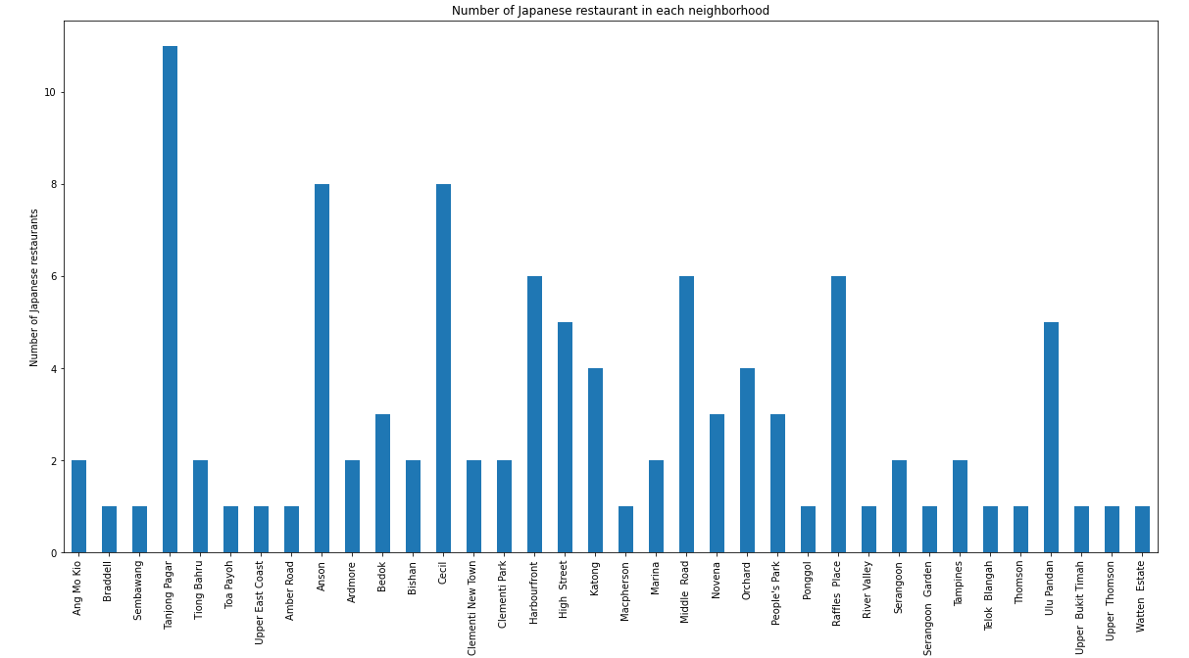
Plot number of Japanese restaurant in each neighborhood

Slide 7
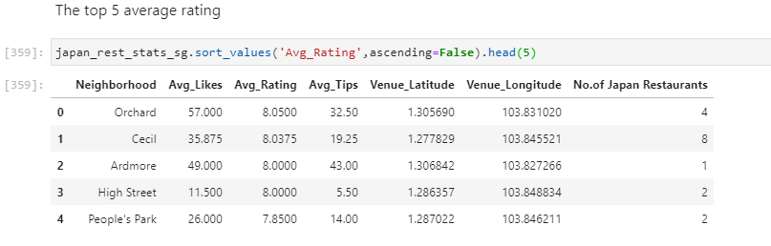
Top 5 neighborhood with high average rating

Slide 8
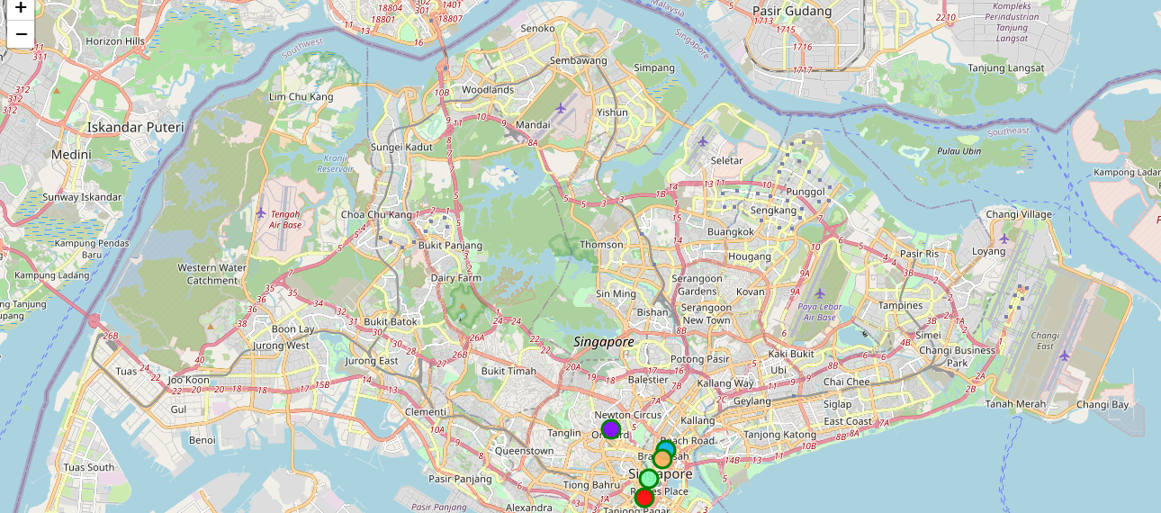
Top 5 best rated Japanese restaurant

Slide 9
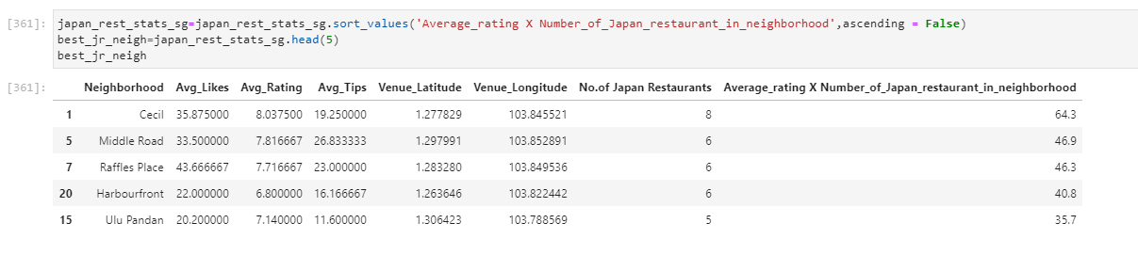
Top 5 neighborhood with high score which equals to (average rating * no. of Japanese restaurant in the neighborhood)
The neighborhood to stay, which has more Japanese restaurant, and average rating is high

Slide 10
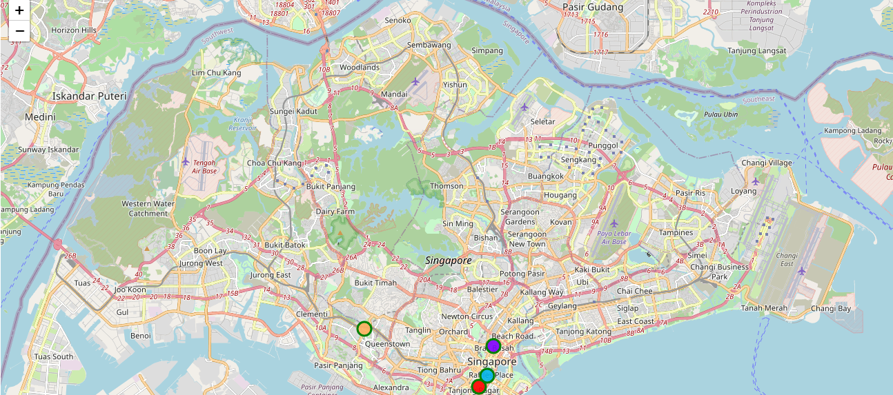
Top 5 neighborhood with high score

Slide 11
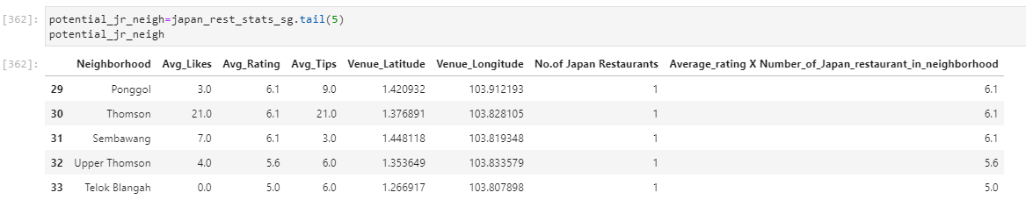
Neighborhood with low score which equals to (average rating * no. of Japanese restaurant in the neighborhood)
The neighborhood with less competition to open new Japanese restaurant

Slide 12
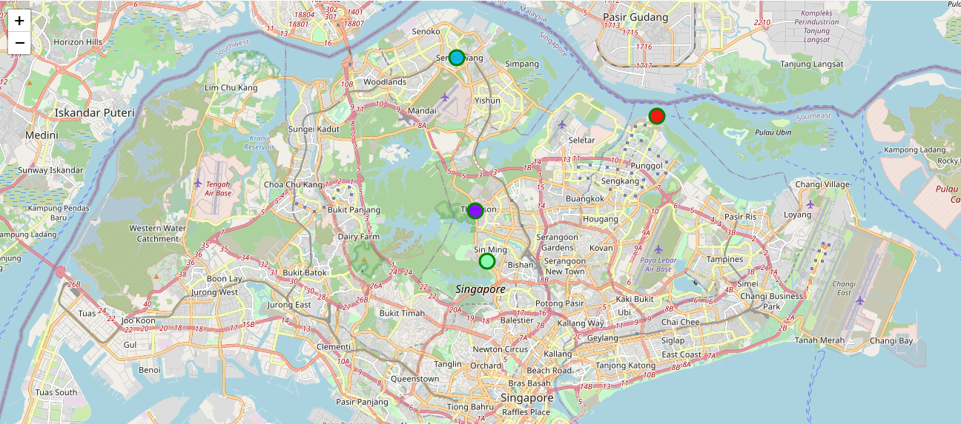
Top 5 neighborhood to open new Japanese restaurant

